Slide 1

Positive Approaches to Children's Behaviours
Understanding behaviours and promoting positive responses is a key feature of the Portage approach
Notes:
Performance of Presenters: total Time 120 minutes
How this links to the Portage Principles and approach.
Discuss the developmental nature of children’s behaviour, referring to previous work in earlier modules
Consider behaviour as communication and to think about what message a child may be giving
Describe the smaller steps approach to changing behaviour
Discuss a model for understanding children’s behaviour in its setting/environment
Describe the value of rewards in supporting children’s development
Describe a variety of strategies that alter setting/environment to lessen the chances of unwanted behaviour occurring
Provide opportunities for participants to reflect on their own situations
Describe a simple model for recording the strategies used and their effectiveness
Ensure that this module builds on and consolidates earlier learning

Slide 2
Outcomes for Participants:
Positive Approaches to Children’s Behaviour
To be aware of the ‘age appropriateness’ of children’s emotional self-regulation
To be aware of and be able to identify the possible messages being communicated through behaviour
To identify possible reasons for children’s behaviour
Look at a behaviour plan using skills and strategies to promote positive emotional self-regulation
Notes:
Share expected outcomes for participants from this module
The most important point here is the clear link between the rest of the workshop and how the skills and concepts introduced here build on previous learning about the Portage Model.
Be aware of ‘age appropriateness’ of behaviour
Be aware of and able to identify the possible messages being communicated through behaviour
Identify possible reasons for children’s behaviour in own setting
Complete a behaviour plan using skills and strategies learned to promote positive behaviour

Slide 3
Positive Approaches to Children’s Behaviour: Objectives
Participants will be able to:
Consider what is age-appropriate behaviour
Name the four common functions of behaviour
Consider what messages might be communicated through behaviour
Understand how settings and triggers can be changed to modify behaviour
List what information could be included in a behaviour plan using skills and strategies learned to promote positive behaviour
Notes:
Share expected outcomes for participants from this module
The most important point here is the clear link between the rest of the workshop and how the skills and concepts introduced here build on previous learning about the Portage Model.

Slide 4
The Portage Model
Structured Teaching
Family Focus
Child-Led Play
Promoting positive responses
is a central theme of the Portage
approach and can feature in
all three elements of the
Portage Model
Notes:
Emphasise:
positive model
clear language
setting of clear LTGs
breaking goals into manageable steps
Focus in this module is on bringing it all together into a Behaviour plan
Children’s behaviour can be understood and responded to within the Portage Principles and Model
The most important point here is the clear link between the rest of the workshop and how the skills and concepts introduced here build on previous learning about the Portage Model.

Slide 5
Guidance on Supporting Behaviour
Understanding the child's perspective
Establishing clear boundaries and setting reasonable expectations
Discussion with parents and carers
Praising children when wanted behaviour occurs
Promoting positive behavioural responses
Giving children every chance to regulate their responses
Developing skills to co-operate with others
Notes:
Recap on current guidance and that this module looks at the reasons why behaviour may occur and how we can look at this in a positive way to support change. We will not cover any specialist techniques or those that are not in line with the Portage Principles.

Slide 6
Self-Regulation and Developmental Age
Behaviours are linked to developmental level rather than chronological age
Consider whether we are expecting too much from children with Special Educational Needs and Disabilities who are developmentally younger than their years
Notes:
The aim of this part of the presentation is to encourage participants to think about how we might expect more appropriate behaviour from children than they are capable of, particularly if they are developmentally younger than their chronological age
Knowledge of the child’s developmental level (baseline) is essential for planning behaviour change
Important when considering behaviour
Young children display how they are feeling in the moment; developmentally, they are not yet able to think about how their emotions change
They can observe how others respond but are unlikely to be able to think about why

Slide 7
Activity 1: Developmental Levels
Sort the statements into developmental age levels.
Pink for Personal and Social Development
Blue for Communication
Turquoise for Understanding the World
Notes:
Activity One
Worksheet to be printed out, laminated and cut into the statements. Each table to sort into expected typical development. Ensure you have a master copy of the dev levels to make feedback easier.
Once all completed feedback as whole group activity
The aim of this part of the presentation is to encourage participants to think about how we might expect more appropriate behaviour from children than they are capable of, particularly if they are developmentally younger than their chronological age
Knowledge of the child’s developmental level (baseline) is essential for planning behaviour change
Developmental levels in the activity are from the Portage best practice Assessment Checklist (KCC)

Slide 8
Development linked to SEND
From Revised EYFS 2020, Julian Grenier
“Language development is central to self-regulation; children use language to guide their actions and plans. Pretend play gives many opportunities for children to focus their thinking, persist and plan ahead”
Many children with SEND have language and communication delay resulting in emotional regulation difficulties where they are not able to get their needs met.
Notes:
Unwanted behaviour is not specific to children with SEND but, communication difficulties may also have an impact
Some descriptions of two year old behaviour is open to interpretation e.g. ‘tantrums’, ‘stubborn’, ‘challenging behaviour’ and ‘terrible two’s’. None of these terms are in keeping with the Portage model as the language is neither clear nor positive. Trainers may wish to clarify this with participants and highlight the cloudy language. The purpose of including this information is to draw similarities with behaviour that is seen in typically developing children and emphasise that children with SEND may have additional communication difficulties that contribute to their ability to manage this behaviour
Changing ‘challenging behaviour’ and ‘terrible twos’ to describe what the child is actually doing removes negative labelling.
The last highlighted point leads on to the next slide

Slide 9
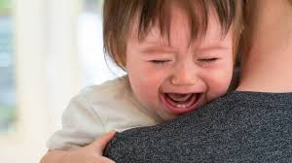
Communicational Intent of Behaviour
My needs are not being met
I want/like
I don’t want/don’t like
Emotions
Pain and discomfort
Notes:
List possible messages the child might be trying to communicate through their behaviour
Link this to the quote on the previous slide regarding children with SEND and behaviour – COMMUNICATION DIFFICULTIES MAY ALSO HAVE AN IMPACT
When children lack the communication and/or social skills to be able to express what they need or want, unwanted behaviours may occur.
When children’s behaviour is challenging it may help to think about what message they are trying to communicate, such as:
Elaborate on each point as you read it – ask for ideas
I’m tired/hungry/nappy needs changing
I don’t understand
I haven’t finished
I’m not interested
No one’s engaging with me
You’re going too quickly for me;
I can’t see /hear you
Additional for children with SEND:
I don’t like being touched
I don’t like what you are wearing/ how you smell.
You’re too close/loud/quiet
I don’t want to look at you
Too much information/ It’s too difficult;
I don’t want to do it - avoidance of that task or another one
I’ve finished
Attention seeking

Slide 10
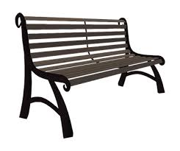

What is the function of behaviour?
It could be…
Sensory
Escape
Attention
Tangible
Notes:
A behaviour that a person engages in repeatedly will serve some kind of function for them (‘O ‘Neil 1997)
If a behaviour is occurring repeatedly, it is likely to be serving some sort of function otherwise it wouldn’t continue to occur.
If we can establish the function of behaviour, we can more easily work out why we behave in a certain way
SEAT 4 demonstrates the common functions of behaviour. Consider that behaviour can serve more than one function.
1 to gain or stop sensory information
2 to escape or avoid a situation
3 to gain or avoid attention
4 To get something tangible an object or an activity
NAS website has lots of good examples and strategies for dealing with Sensory Behaviours in the Sensory section: www.autism.org.uk/about/behaviour/sensoryworld
Mention: www.contact.org.uk- download: Understanding Your Child’s behaviour

Slide 11
SENSORY
Hypersensitivity – constantly overwhelmed by sensory information
Fight or flight mode
Avoidance of sensory stimulation
Notes:
Some behaviours occur to seek or avoid sensory information.
Hypersensitivity is when a child is over sensitive so therefore receives too much information through their sensory systems. If a child is gaining too much information from the environment this may lead to sensory avoiding behaviours. The function of the behaviour is to avoid the sensory stimulation that is making them feel overwhelmed. The function of the behaviour is to remove an internal sensation that is distressing and to help tolerate things they find difficult to cope with.
Following is from www.paautism.org/seat why, when, and how you can help
Why to block out or avoid a sensory experience
How to help find an activity that provides the same sensory experience
Example an individual is humming loudly to hear their own voice to cover other sounds they don’t like. Offer noise cancelling headphones that reduce the sound or play music they like.
Quick Fix an individual is humming loudly to cover other environmental sounds and you give them a light up stick, this is not related to the voice humming, it may have a short term effect using distraction but not help the sensory need for the behaviour.
What to do proactively have available access to a variety of quieter sounds throughout the day to build tolerance e.g. if the doorbell is loud turn it down and allow the child to activate it when they are at the door and gradually increase the level. Or provide a quiet area that can be gradually moved to a more noisy environment.

Slide 12
What you may see:
Fixated on detail
Dislike of bright lights, unpredictable sounds (covers ears), makes repetitive sounds to block out others
Aversion to smell of objects and people
Pulls away from touch
Refusal to wear certain clothing
Dislike of food textures
Fear of feet leaving the ground
Disorientated after spinning, running or jumping
Notes:
Talk through the slide.
Activities that provide movement and pressure to help the child bring down their sensory levels to a calm alert state and help them to maintain this.
E.g. Bouncing on an exercise ball, swinging in a blanket activities with regular rhythmic movement, pressure on shoulders or hips constant or intermittent.

Slide 13
SENSORY
Hyposensitivity – constantly crave intense sensations
Seeking sensory stimulation
Self-stimulatory behaviours
Notes:
Some behaviours occur to seek sensory information
The function of the behaviour is to get some form of internal sensation that is pleasing or calming to them. By engaging in sensory behaviours it can help the child return to a calm and alert state. Some of these behaviours may be socially inappropriate. E.g. Sniffing strangers. We need to understand the function of the behaviour so that we can provide an alternative activity that meets the need whilst keeping the child safe, e.g give the child a handkerchief with calming oils on it to sniff.
Take into account the time of day, seasons and environment and the effect this can have on the child
Provide any stimulation in a more positive way and have access to sensory items appropriate for the individual child.
Keep tasks small with frequent breaks and build in activities that provide the child with body awareness feedback to help them reach a calm, alert state, calm enough to focus, alert enough to engage
Following is from www.paautism.org/seat why, when, and how you can help
Why To seek out and engage with a sensory experience How to help find an activity that provides strong same sensory feedback
Example an individual is mouthing and chewing on clothing. How to help Provide appropriate item to mouth and chew on such as chewellery, use of vibrating toys or tooth brush to use on the face, chewy crunchy foods., giving regular times where the child an gain body awareness feedback throughout the day.

Slide 14
What you may see:
Fixated on detail
Seeking bright lights, loud sounds , making repetitive sounds, humming
Seeking smell of objects and people
Wants to wear tight fitting clothing
Craving hot and spicy foods
Seeking rough and tumble
Wanting more after spinning, running or jumping
Craving touch
Notes:
Keep tasks small with frequent breaks and build in activities that provide the child with body awareness feedback to help them reach a calm, alert state, calm enough to focus, alert enough to engage

Slide 15
Inconsistency of Perception:
Be aware, there can be levels of hypersensitivity and hyposensitivity in any individual child.
This is a complex area so specialist advice may be required to further assess the child’s needs e.g. a specialist Occupational Therapist

Slide 16
ESCAPE
Running
Hitting
Throwing
Biting
Spitting
Shouting/screaming
Hiding
Notes:
Highlight the fact that the behaviours listed in this slide, the one about Attention seeking and gaining something Tangible are often the same. It’s our job to interpret the function of the behaviours by using our observation skills and knowledge of the child.
To get out of unwanted activities or interactions
Not all behaviours occur so the child can obtain something, many occur because they want to get away from something or avoid something altogether (Miltenberger 2008)
Examples
A child may scream and cry and shout for the adult to stop the activity or the child may hide or even go to sleep to avoid the engagement with people or the environment.
Following is from www.paautism.org/seat why, when, and how you can help
Why to get out of unwanted activities or interactions
When something is hard causes unpleasant sensation not fun
How to help break the task down into smaller steps, have a break show how to ask for a break provide lots of praise.
Example child is asked to tidy away the toys they start to have a tantrum so ask them to pick up one item and then praise, adult completes the rest of the task.
Quick Fix child starts to tantrum when they are asked to tidy up the toys adult then tidy's all the toys and doesn’t ask them to do this again concerned it will bring on a tantrum not dealing with the behaviour
What to do proactively keep tasks small with frequent breaks and build in motivating and rewarding activities. Provide a first this then that approach, offer choices, alter the length of the task

Slide 17
ATTENTION
Running
Hitting
Throwing
Biting
Spitting
Shouting/screaming
Hiding
Pulling
Please and thank you
Constantly saying your name
Notes:
Why to get access to people or interventions
A child may engage in a certain behaviour to get some form of social attention or a reaction from other people.
A child may engage in any of these behaviours to get people to look at them, laugh at them, play with them, hug or even tell them off. For some children having any type of attention is what they are seeking whether it is negative or positive.
Better to have ‘bad’ attention than no attention at all (Cooper, Heron, Howard 2007)
Following is from www.paautism.org/seat why, when, and how you can help
Why to access to people or interactions
When not getting enough attention or interaction
How to help Provide lots of praise for appropriate requests for your attention, teach a child to ask for your attention appropriately make time
Example the child is screaming while two adults are talking or could be when using the phone. Let the child know that when they are quiet, they will get your attention. Praise for a moment of quiet.
Quick Fix The child is screaming when two adults are talking stop the conversation and give the child your undivided attention.
What to do proactively let the child know you are going to talk to the other adult, give them an action such as tapping your arm if they need to speak, provide lots of attention and praise at other times of the day. Provide positive feedback or attention before the behaviour happens.

Slide 18
TANGIBLE (CONCRETE)
Running
Hitting
Grabbing
Climbing
Crying/screaming
Please and thank you
Constantly saying your name
Notes:
Some behaviours occur so the child can obtain a tangible item or gain access to a desired activity.
Example a child may scream and shout because they want a toy , item of food, iPad, trip to the park etc
Following is from www.paautism.org/seat why, when, and how you can help
Why to get access to items/activities
When Something wanted is not available
How to help offer an alternative, use the ‘first this… then that… ‘ approach
Example child is upset that the shop/ café is closed where they usually have a drink. Show them an alternative shop or café to go to and get their drink
Quick fix child is crying because the shop café they usually go to is closed so they are given the tablet to play with instead. Not giving the child a learning opportunity to see what the alternatives might be.
What to do proactively Use ‘first this… then that… ‘ approach
use a timer or rain maker to signify when an activity is finishing. Offer choices, alter the length of the task. Try a transitional object or activity, have an alternative in mind, plan ahead.

Slide 19
Activity 2:
Think about the ‘communicative intent’ of behaviour
Look at the cartoons/photos
Discuss the possible message the child is trying to communicate and how this is being displayed in terms of SEAT
Notes:
Cartoon or photo on slides 19.20.21.22 Think about the communicative intent of the behaviour which function of Behaviour (SEAT) can best describe the behaviour shown in the cartoon
discuss as a whole group what the communicative intent and children's responses could be saying and how are the adults responding.
I want
I don’t like
My needs are not being met
Emotional
Pain and discomfort
Behaviour in categories of SEAT

Slide 20
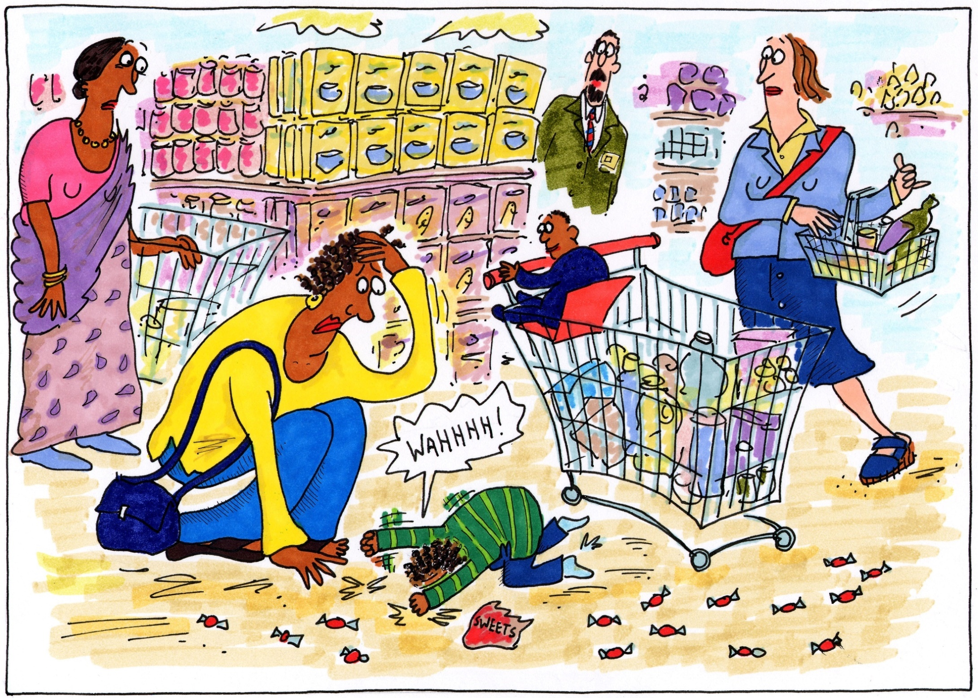

Slide 21
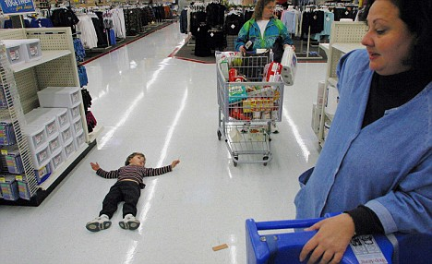

Slide 22
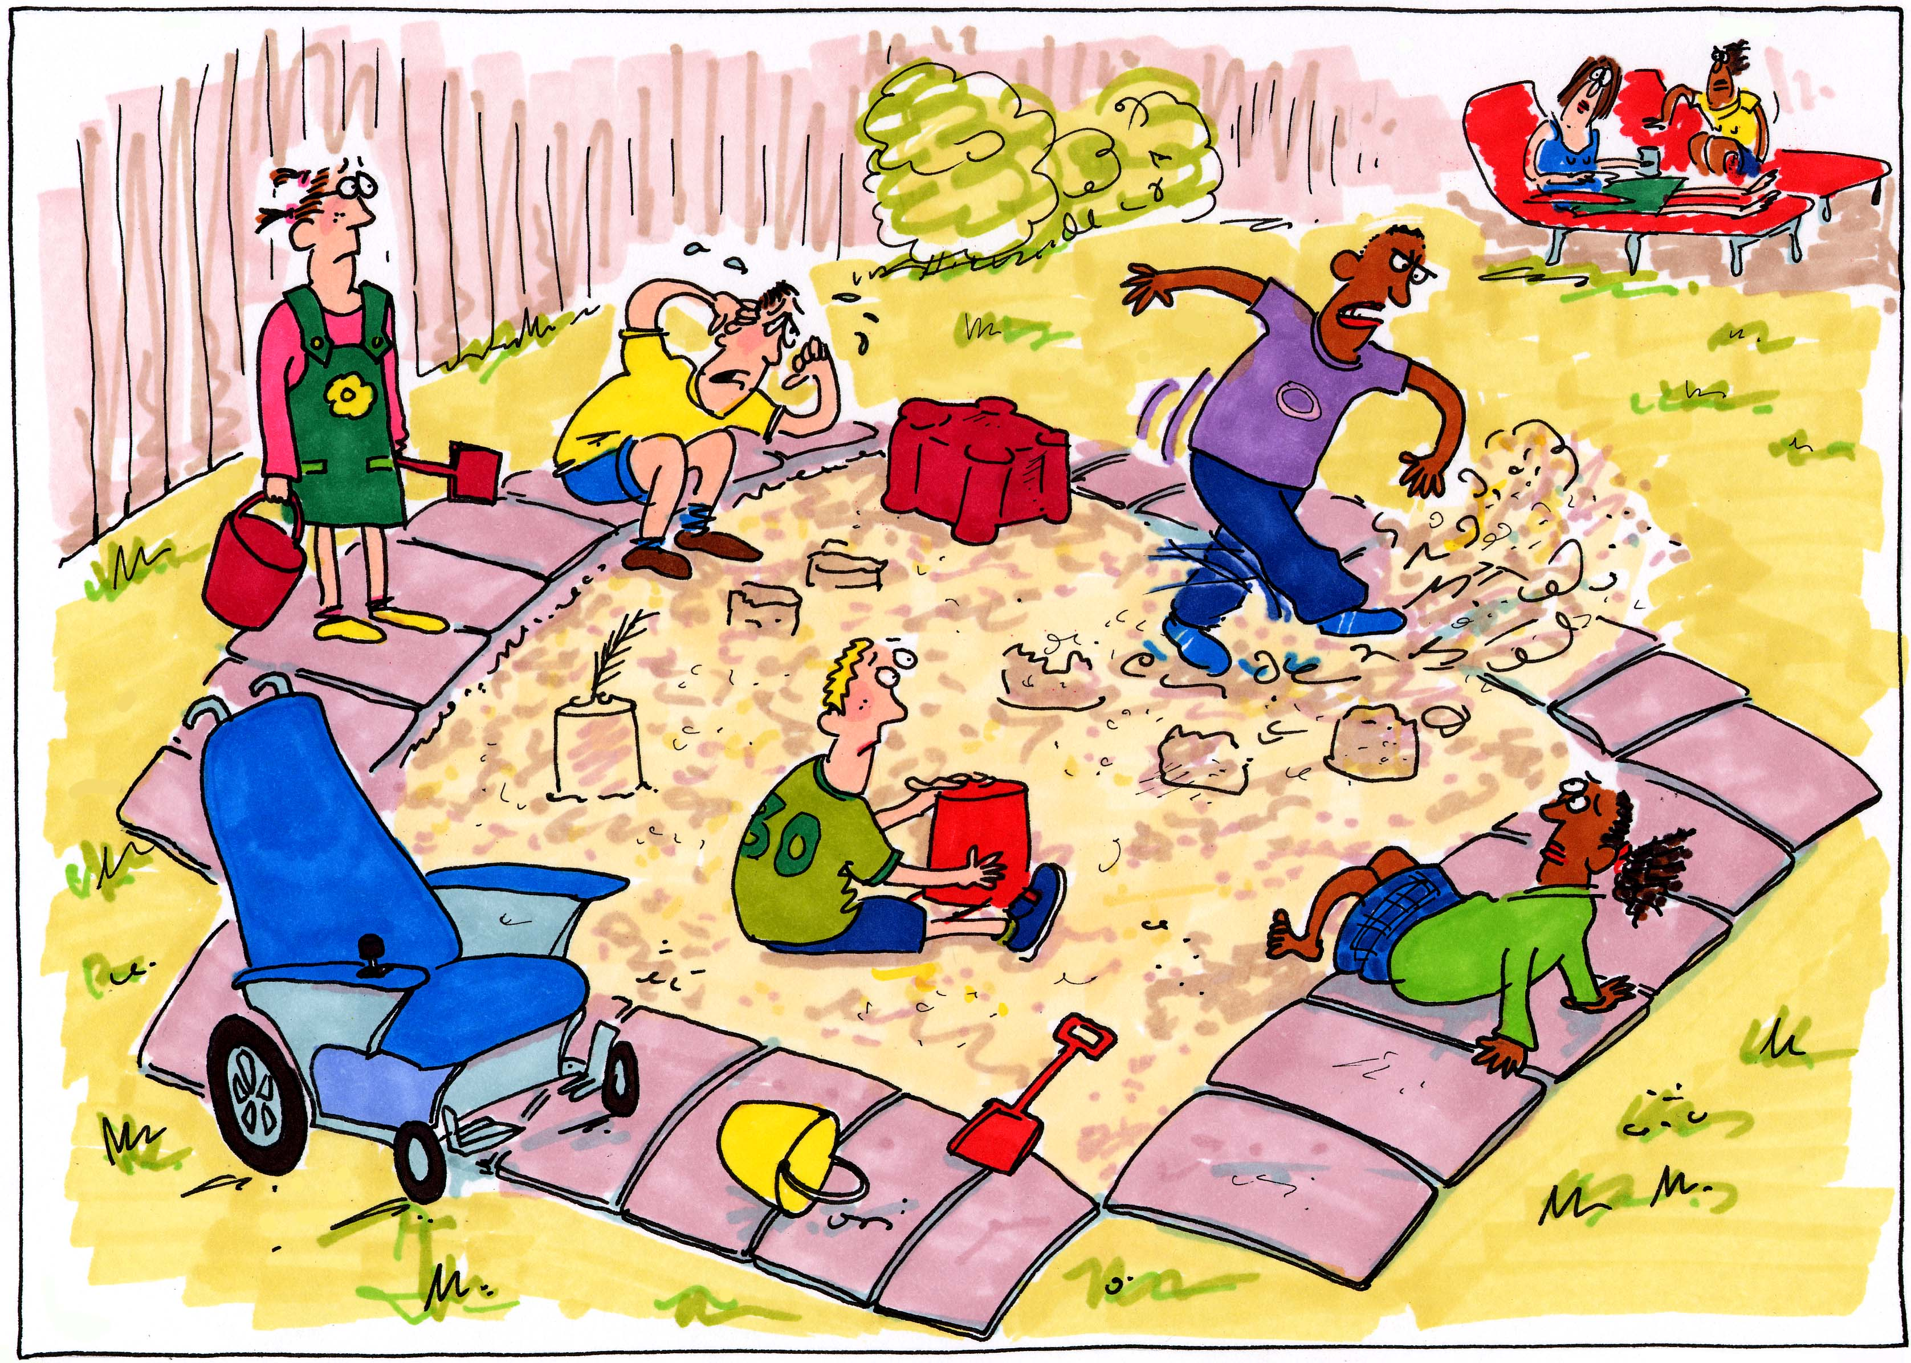

Slide 23
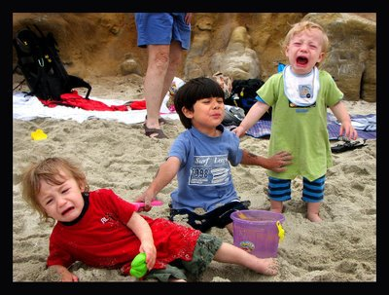

Slide 24
Encouraging Change
Work in partnership with parents to ensure successful change in a child’s emotional responses
Emotional responses which are rewarded are more likely to occur again and emotional responses which are not rewarded are less likely to occur again
Aim to replace unwanted emotional responses with a positive response that is just as or more rewarding
Notes:
Aim to work together with parents to set shared goals for behaviour change - may see quicker and longer lasting change
Partnership will need to be effective and flexible enough to maintain positive communication during the process of recognising the child’s specific needs and working towards changing behaviour
Point 2 might seem obvious but it highlights the fact that we sometimes inadvertently reward unwanted behaviours. Examples can be given.
Example for point 2 on slide:
Quiet child who plays alone, delayed communication skills wants adult to attend to need, can’t ask - gets attention if they behave inappropriately
Skills learned in the Using Clear Language and the Small Steps Approach modules will be useful when we are considering changing behaviour - this is key – often a need for child to learn a specific skill

Slide 25

Small Steps Towards Changing a Child’s Responses
Change in the frequency of the behaviour
Reduction in the amount of help
Gradual change towards the desired behaviour
Notes:
The Portage Model advocates a small steps approach to supporting learning and behaviour. The aim is to work towards a gradual change by breaking the end goal down into manageable steps. More details on next slide.

Slide 26
The Small Steps Approach
Aim for a gradual change in the frequency of the behaviour
If the unwanted behaviour happens less often, we have been successful
Vary the amount of help given
As time goes on:
Gradually shape the behaviour towards the goal
We may need to start by working on the unwanted behaviour in a specific situation but as we are successful, we can work on the behaviour in a wider range of settings
If the desired behaviour happens more often, we have been successful
prompts can be decreased in frequency
prompts can be faded to less obvious ones
less powerful (and easier) rewards can be introduced
rewards can be given intermittently
Notes:
Go through briefly

Slide 27

What is a Reward?
A reward for children should be something that acknowledges and reinforces appropriate behaviour
Discuss some of the things you have used effectively as rewards for children
Why were they effective?
Notes:
Change presenter on this slide.
Emphasise the importance and purpose of rewards for children:
Rewards are incentives - they are given in return for carrying out a desired behaviour or task and therefore must be effective
Rewards are used to help children learn new skills, not as a bribe or coercion
Emphasise the need to be consistent
Explain ‘strong’ i.e. effective and motivating
Emphasise the importance and purpose of rewards for children
What is rewarding to one person may not be to another
Emphasise the need to be consistent
Explain ‘strong’ i.e. effective and motivating
The emphasis of the discussion is to enable participants to consider how individual children find different things rewarding therefore we need to think of the unique child when considering suitable rewards
Trainers may wish to share examples of more unusual rewards they have used for children

Slide 28

Effective Rewards
Motivating
Immediate
Consistent
Used to shape behaviour
Linked to social praise
Faded to leave social reward
Notes:
Motivating:
must capture the child’s attention. No matter how carefully the reward has been chosen, there's no point in rewarding if the child does not know he's been rewarded.
Immediate:
must be given as soon as the appropriate behaviour has been performed to avoid inadvertently rewarding another behaviour
Consistent:
initially the child must be rewarded every time he performs the task
When the behaviour is becoming established, you need to consider rewarding intermittently and fading out altogether so the task is a reward in itself
With consistency this applies to all adults in setting as well as consistent rewards-consider in terms of home as well as setting
Used to shape behaviour:
to help a child learn a new behaviour, we can reward successive steps or approximations to the target behaviour
Linked to social praise:
actual rewards are always paired with social praise
Faded to leave social reward: Example
Well done, hurray and a clap for Freddie ‘ you’ve given me the book’ (Share book with Freddie),
Freddie ‘well done you’ve given me the book’ (share book with Freddie)
Freddie gives the adult the book and they share the book .

Slide 29
Points to Consider
What is rewarding for one child may not be for another
Create situations where children can achieve
Ensure all children in the setting feel rewarded
Parents and staff need to agree the approach
Discuss emotional regulation and rewards with the
parents or carers.
Notes:
Point 2: Read slide and add
Rewards need to be rewarding for the individual – observations will inform what child finds rewarding
Point 4: Read slide and add
Other children may react adversely to the selective rewarding of one child. It can be helpful to look at the rewards available to others involved to make sure that it is possible for any individual to feel rewarded (Give example)
NOTE: The aim eventually is for children to respond to intrinsic rather than tangible rewards i.e. the task or activity will be a reward in itself

Slide 30
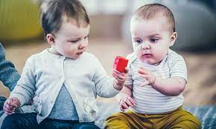
Using Praise
Use praise with all rewards
Be consistent and specific
Be appropriate
Be enthusiastic
Use appropriate body language
Use appropriate words and tone of voice
“Good sharing”
Notes:
Praise should continue once the behaviour is established and more tangible rewards have been withdrawn
Be specific - Praise the specific action or behaviour otherwise the child may link praise to another behaviour - ‘Good boy Thomas for sharing the ball with Simon’
Be appropriate - think about the most appropriate way of doing this for each child including proximity, language, eye contact
Be noticed by the child - so the child realises they are being praised
Presenters to give an example here – use a role play scenario

Slide 31
Positive Responses to a Child’s Behaviour
Advantages | Disadvantages
Ethos of Portage Considered good practice under EYFS More likely to increase the behaviour Positive example to other children Motivational Models desired behaviour to the child | Hard work to maintain exhausting Can be hard to find right rewards Others may resent what they see as ‘special treatment’ Can be focused on an individual rather than whole approach In itself doesn’t develop intrinsic motivation
Notes:
Sheet if AT want participants to record this .
Positive response tell the child what to do and not reprimand them e.g. on the floor instead of get off the table.
Not using a loud voice or shouting.
Using stop instead of no.

Slide 32
Negative Responses
Advantages | Disadvantages
Immediate Low resources Others can see it Appears to deal with the problem | Against Portage model Affects relationships Tells child what not to do Makes adult feel bad Impact on whole setting Gives other children and adults negative impression of child
Notes:
Trainers should point out that the disadvantages of negative responses have greater consequences for the child and whole setting. The issues highlighted with positive responses are mainly things that just need consideration/adapting/fine tuning.
Using naughty step, shouting, telling child off.

Slide 33
Using Observations to Help Understand a Child's Emotional Responses
Helps identify triggers
Highlights environmental factors
Consider how behaviour is maintained
Identify possible adult contributions to behaviour
Show differences between home and pre school
Clarify the behaviour and help set goal
Notes:
Reflect back to previous modules on UCL and LTGs particularly here which show the importance of using observations and discussions with others, before setting goals that are clear in their language and purpose.
Point 1: Triggers Read slide and then: the signals or stimuli that ‘set off’ a particular action, occurring immediately before the commencement of the unacceptable behaviour. Triggers can stop the good behaviour and start the unacceptable behaviour
Point 2 Environment: Read slide and then: All those things going on in the environment or in the background that affect behaviour. These are the stable or relatively stable things in the environment such as: time of day; places; people; ‘tension’ in the environment; weather; hunger

Slide 34


Setting a Long Term Goal
Jared will stop taking other children’s food at snack time
Jared will sit at the table and eat his own snack alongside 2 other children for 5 minutes
If the positive behaviour that we would like to see happen is clear, practitioners have a definite goal to work towards
Notes:
When setting a long term goal around behaviour, we need to be clear about both the current behaviour and what we would like to see happening in the future (i.e. goal should state what we are expecting the child to do, not what they shouldn’t be doing)
This needs to be written in clear language that everyone can understand

Slide 35

Using a STAR Chart for Behaviour
Settings – Where did it happen? Who was there? What else was going on?
Triggers – What happened immediately before? What may have set the behaviour off?
Action – What did the child do?
Responses – What was the response to this?
Notes:
Go through the elements of the STAR model, and share example of a completed chart to illustrate each element
Settings
The physical environment, busy, noisy, hot, dark
Social interactions and relationships within the environment
The activities the child was doing
Childs physical well being , hunger, thirst
Childs thoughts and moods
Childs psychological state, anxiety state
Childs developmental level
Triggers
Something a child wants, food and toys
Something the child dislikes or fears loud noise, dog or spider
Something a child associates with a particular event bath time, bedtime
Actions observable behaviour shown by the child start by describing the action that is of concern
Results events that follow the action

Slide 36
Example STAR Chart
Settings: What was going on at the time? Where did it happen? Who was there? | Triggers: What happened immediately before? What may have set the behaviour off? | Actions; What did the child do? Describe using clear language Identify the Action as the first step | Responses: What was the response to this? What did people do? What else happened afterwards?
Before lunch, small group in outside play area, with key person. | Bill was playing by himself at the water tray. Sarah, Bill’s key person, brought a new child, Meera, over to the water tray and left her with Bill. Meera reached for toys near Bill. | After Sarah moved away, Bill screamed and grabbed all the toys in the water tray. He pushed Meera away from the tray. | Bill continued to scream for 2 minutes and the adult had to remove him from the area as he kept trying to push Meera away from the water. Meera cried when Bill approached her.
Notes:
In a STAR chart, the Action should be recorded first, using clear language.
Participants may use charts of their own to show triggers and settings for behaviours - this is fine if they are working well, stress that a STAR chart is only one example of what can be used.
Go through model with participants. This can be used as a behaviour diary over several days/weeks

Slide 37


Changing Settings and Triggers
Changing the environment
Avoiding the situation or distracting
Offering choices
Providing clear rules, modelling & forewarning
Catching the “good” and rewarding it
Teaching a new skill. Developing communication skills
Notes:
Changing settings and triggers
Changing settings and triggers should be the first strategy used as it is often the most effective and can help to avoid a behaviour occurring:
Example. When its time to come in from outside play that the child loves say, “its snack time” and not “it's time to go inside”
Changing the environment - Place, materials, activity, social experience
Avoiding the situation or distracting
Offering choices - Swapping bad news for good
Providing clear rules, modelling & forewarning – Tell and show child what to do.
Catching the “good” and rewarding it
Teaching a new skill - The behaviour you need to see
Developing communication skills - Providing a way for the child to communicate and to understand

Slide 38
Activity 3:
Changing Setting and triggers
Consider the scenarios on the cards
Discuss ways the settings and/or triggers could be changed to reduce the behaviour occurring again
Notes:
The aim of the activity is to give participants practice of looking at a range of possible settings and triggers and think of how they might be changed to promote positive behaviour

Slide 39
Changing Responses
The way the adults respond to the child
What the adult expects from the child
Notes:
This includes what the adult does or says, their body language, tone of voice, and also what the adult expects the child to do, e.g. asking them to ‘say sorry’ to another child
Remind that changing settings and triggers is often easier and more effective than changing responses. For example, a child may behave in a certain way to avoid doing something. If an adult removes the child from the activity, he may be getting rewarded, so the adult needs to change the way they respond. This can be more difficult.
Discuss strategies for changing responses, such as the way adults react when a child behaves in a certain way

Slide 40
Developing an Emotional Regulation Plan
Settings and Triggers | Emotional regulation unwanted response
What are the triggers that seem to set off the response? What aspects of the environment does the child find difficult (places, people, sounds, sights, smells)? Are there particular times of the day when the behaviour is more likely to occur? | Describe the current (unwanted) behaviour using CLEAR language Agree the behaviour GOAL
How to help me avoid the unwanted response | How to help me regulate my emotions
Changing the environment Avoiding the situation Offering choices Providing clear rules – and model Distracting Catching the “good” and rewarding it Teach new skills that will help the child work towards their behaviour goal | This is unique to each child and will depend on adult observations and knowledge of calming strategies for individual children when they find things difficult. This may include: Calm voice and limited language Move to ‘quiet’ area Clear instructions e.g. ‘hands down’
Notes:
Behaviour plans help focus all involved on the next steps towards changing a behaviour. They do not necessarily lead to a complete change in behaviour but ensure that parents and professionals agree a way forwards and a consistent approach.
Remind of the need for small steps and that a plan would not expect the behaviour to completely change but would focus on one step towards the change.
The emphasis should be on bringing all elements of this module together in the behaviour plan: changing settings, triggers and responses
Plans need to be agreed by everyone involved to ensure the approach is consistent and they are all signed up to delivering this.
Behaviour will often get worse before it improves or be replaced by a different behaviour.

Slide 41
Example of an Emotional Regulation Plan
Settings and Triggers | Current behaviour | Behaviour Goal
Being asked to share a toy or join in a sharing game triggers the behaviour | Bill screams repeated holds onto toys when asked to share a toy or activity | Bill will play alongside another child for 2 minutes
How to help me avoid the unwanted response | How to help me regulate my emotions
At a calm time the adult models sharing the activity with Bill and another child Set up a small group activity with carefully chosen children Adult to sit next to Bill during group activities and model good sharing | Adult to move Bill away and sit with him in a quiet area until he is calm Use clear language in a calm voice to say what is going to happen, ‘Bill, sit here, train book.’
Notes:
.Behaviour plan needs to use the elements of previous modules – using clear language, small steps approach and planning for success. Plan makes up the Planning, recording and sharing element
The emphasis should be on bringing all elements of this module together in the behaviour plan: changing settings, triggers and responses

Slide 42
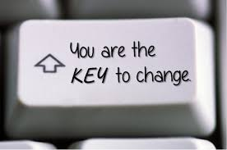
Checking for Positive Change
Are the rewards motivating?
Is there consistency?
Are ‘negative’ consequences really negative to the child?
Are we expecting too much in too short a time?
Notes:
Review the behaviour plan frequently and if the change in behaviour doesn’t happen ask the above questions
Emphasis on the importance of reflecting on the impact of the behaviour plan and changing it as needed.
Link this back to teaching targets and LTG’s – can be changed if not appropriate;
Graduated response – “assess, plan, do, review cycle “

Slide 43
Summary
Behaviour and child's emotional self regulation is linked to developmental, not chronological age
Consider what the child is trying to communicate
The Portage Model advocates a small steps approach to changing behaviour
Rewards can be helpful if considered fully and used effectively
Consider a STAR chart and a behaviour plan to identify a way forward
Notes:
Recap key points

Slide 44
partnership
generalising skills
celebrating success
inclusion
celebrating diversity
small steps
PORTAGE PRINCIPLES
enabling
being positive
supporting
looking forward
whole child, family and community
practical, immediate, relevant
Notes:
All Portage principles are considered and applied in this module

Slide 45
Outcomes for Participants:
To be aware of ‘age appropriateness’ of behaviour
To be aware of and able to identify the possible messages being communicated
To identify possible reasons for children’s behaviour in own setting
To complete a group assignment on promoting positive behaviour using a behaviour plan
Notes:
Revisit expected outcomes for participants

Slide 46
Positive Approaches to Children’s Behaviour: Objectives
Participants will be able to:
State what is age-appropriate behaviour
Name the four common functions of behaviour (SEAT)
State what messages might be communicated through behaviour
State how settings and triggers can be changed to modify behaviour
List what information could be included in a behaviour plan using skills and strategies learned to promote positive behaviour
Notes:
Share expected outcomes for participants from this module
The most important point here is the clear link between the rest of the workshop and how the skills and concepts introduced here build on previous learning about the Portage Model.
Remind participants to complete the evaluation
Also the Portage suitcase what will they take away from the workshop to try and use
Remind about the follow up session.

