Slide 1

Using a Small Steps Approach
Breaking a learning goal down into smaller steps will make it easier for a child to achieve and is central to the Portage Model
Notes:
PERFORMANCE OF TRAINERS: Total Time 135 minutes
Introduce the concept of breaking tasks into small steps
Show how breaking tasks and activities into small steps makes learning easier for children
Introduce strategies for breaking down tasks based on changing behaviour, conditions or degree of success
Ensure that this module builds on and consolidates earlier learning

Slide 2
Outcomes for Participants:
Small Steps Approach
To show you are able to break down tasks in a variety of ways to make learning easier
To plan a sequence of small steps towards a Long Term Goal from a baseline.
Notes:
OUTCOMES FOR PARTICIPANTS:
Share outcomes for participants
Show how they can break down tasks in a variety of ways to make learning easier
Plan a sequence of small steps towards a given Long Term Goal from where the child is now (baseline)

Slide 3
Small Steps Approach:
Objectives
Participants will be able to:
Break a task down into component skills as a task analysis
Name the different types of prompts that support learning
State what elements can be changed to make a task easier
Plan a sequence of small steps towards a Long Term Goal.
Notes:
Share the expected objectives for participants

Slide 4


Long Term Goal
will be able to do this
Baseline
can do this now
Notes:
Introduction to Small Steps Approach
This session focuses on the skills needed to break tasks into small steps
Recap on Clear Language and Planning for Success
Recap on module on using Clear Language as these help inform and support the small steps approach

Slide 5
A Small Steps Approach
In the Portage Model, this is breaking down a Long Term Goal into smaller steps that will help a child reach the goal.
These smaller steps are known as the component skills.
Notes:
Small Steps Approach
Key Aspect of the Portage Model
The aim is to move from baseline to Long Term Goal
Often this will be a big step, so we need to break a goal down into very small steps (component skills)
Each skill is a step on the way to the goal
Early Years Providers should already be familiar with using Mid- and Short-term plans for the children in their care, to break down their Long Term Plans and particularly as a way of making learning steps achievable.
It is important to emphasise that some children with SEND require goals breaking down into tiny steps in order to achieve success. This is the essence of Portage and the reason why it is so successful.
N.B. The term ‘Task Analysis’ is used in the participant’s notes to describe the process by which tasks are broken down into smaller steps. Trainers may wish to use this term with participants during their explanations. It should be emphasised that task analysis is applied here as a small steps approach to thinking about how to move an individual child forward towards achieving their goal, and not as a prescriptive pathway that all children will follow in the same way or at the same rate.

Slide 6
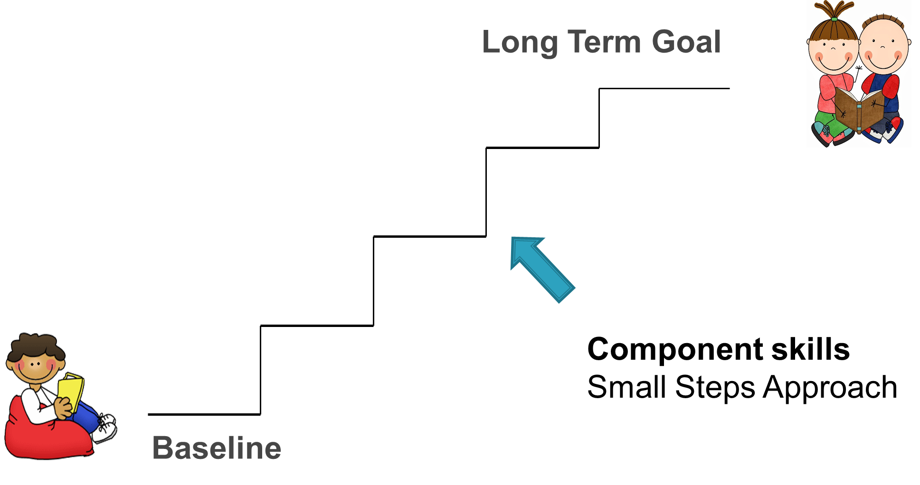
Notes:
Whole Group Activity:
Wrap a box
Component Skills
Need scissors, tape, wrapping paper, and a box.
Participants give one instruction each, going round the group to the trainer who will follow their instructions how to wrap the box the activity is completed when the box is wrapped.
Briefly recap using clear language,
Even the simplest task may be made up of many steps. This can be seen by watching someone carry out a task and recording the actions in sequence.
The purpose of the activity is to develop an understanding of component skills

Slide 7
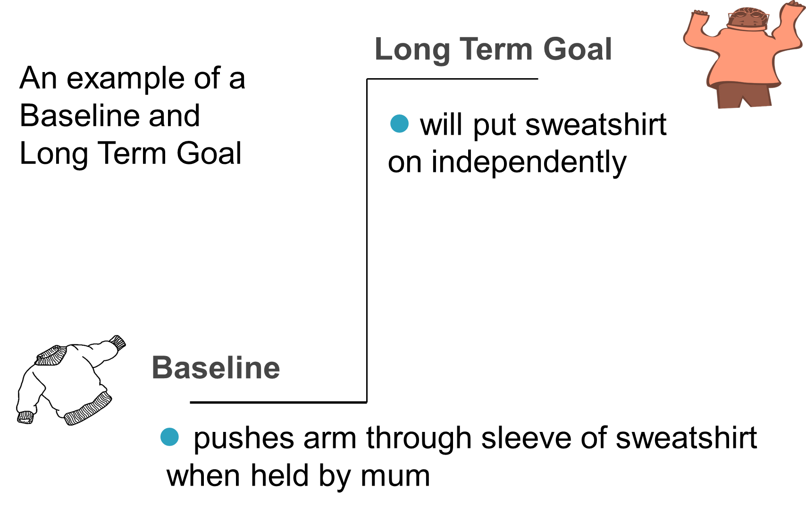

Slide 8

Activity
Think about the long term goal of ‘putting on a sweatshirt’.
What are the component skills you need to learn to be able to do this?
In small groups choose one person to put on the sweatshirt, following step by step instructions given by the rest of the group
Then complete Activity Sheet 1
Notes:
Even the simplest task may be made up of many steps. This can be seen by watching someone carry out a task and recording the actions in sequence.
The purpose of the activity is to develop an understanding of component skills
Ask participants to work in small groups to consider the steps involved in putting on a sweatshirt and to record these on Activity Sheet 1
Activity Putting on a Sweatshirt
Trainers may wish to use a different activity here, or use alternative equipment/resources e.g., a t-shirt instead of a sweatshirt.
Briefly talk through the example of putting on a sweatshirt and recap clear language, baseline & long term goal, to consolidate previous learning. Point out that a range of skills need to be taught to help the child work towards the long term goal
Even the simplest task may be made up of many steps. This can be seen by watching someone carry out a task and recording the actions in sequence.
The purpose of the activity is to develop an understanding of component skills
Ask participants to work in small groups, with one person putting on the sweatshirt. The group to observe the steps involved in putting on a sweatshirt and to record these on Activity Sheet 1.
Completion of Activity sheet 1 (or other similar activity) is essential to ensure participants carry out a written exercise on the small steps approach – a key aspect of the course.
Feedback from the activity should include:
How difficult was the task to break down?
Did participants manage to be clear in language used?
Did they manage to achieve the task?

Slide 9
Breaking Down into Small Steps
Behaviour
What the child is expected to do
Conditions
Prompts
Success Criteria
TO WHAT DEGREE OF SUCCESS?
Materials
Instructions
“DOES WHAT?”
UNDER WHAT CONDITIONS?
Context
Notes:
Breaking down into small steps
The small steps to the Long Term Goal are different for each child. Identifying these steps depends on knowledge and experience of the child. Link to the Holistic Profile.
An important aspect of Portage is ensuring success for the child
Changing some or all of the elements of a teaching target can make a task easier. So we can change either:
the behaviour, or
the conditions, or
the degree of success, or
change a combination of these
This slide introduces the next section on ways of breaking down learning into smaller steps and is key.

Slide 10
Changing Behaviour
Behaviour
What the child is expected to do
“DOES WHAT?”
Notes:
A task can be made easier by changing the materials e.g. Catching a large beach ball rather than a tennis ball.

Slide 11
Changing Behaviour
Teach the easiest part first
Hardest
Easiest
Notes:
One way of making a task or activity easier for a child is to identify the small steps that make up a more complex task and to think about the order in which we will teach them
For any child, some parts will be easier than others. We can order the tasks from easiest to hardest. We teach the easiest first and share the task with the child by doing the harder parts for them

Slide 12

Discussion
Using Activity Sheet 2, identify some of the easier and harder components of putting on a sweatshirt
Feedback to whole group
Notes:
Activity 2
Easier & Harder Components of Putting on a Sweatshirt
Using Activity Sheet 2, participants return to the sweatshirt task analysis and think about which component skills were easier and harder
PP13 gives some examples of easier & harder components, but stress again that there is no single way and the order may vary depending on the child.
The return to the sweatshirt activity will help participants recognise that all activities have easier and harder components

Slide 13

Putting on a Sweatshirt
Pulling sweatshirt over head
Pulling sweatshirt down over tummy once arms are in sleeves
Finding front of sweatshirt
Pushing first arm through sleeve
Locating second arm hole
Some Easier Components
Some Harder Components
Notes:
Examples of easier & harder components, but stress again that there is no single way and the order may vary depending on the child.

Slide 14

Activity
Think about the following activity:
‘Building a tower of 4 bricks’
How could we support a child to make it easier for them to achieve this task?
Try it out!
Notes:
Activity: Helping children to complete an activity
Emphasise that initially we may need to give children a lot of help to achieve, particularly for harder elements of an activity or task
Discussion activity – in what ways could we support a child to complete the task (building a tower of 4 bricks)?
Feedback from whole group ideas of how to help. This will start participants thinking about the help initially needed to achieve an activity. One way adults can help is by putting the first three bricks in place and asking the child to just put the last brick on top, which leads on to the next slide.
4 bricks per group
Trainers may wish to use alternative resources here to illustrate the same point, e.g. an inset puzzle or shape sorter

Slide 15


Helping Children to Complete an Activity
If a child completes the last step of an activity, they are rewarded by being the one to ‘finish’.
Gradually, the child can be asked to complete additional parts of the task, slowly building up the demand and reducing the level of adult support
Notes:
Helping Children to Complete an Activity
This is an approach that can be useful when introducing a new activity to a child. It works better for certain activities/tasks more than others.
Trainers may wish to use the term
‘backward chaining’ with participants as this is the technique upon which the ideas in this section are based.
Ask participants to think of other activities that this technique might work with (examples include bricks, puzzles, putting on a coat, posting games etc.)
Examples of resources / activities e.g. inset puzzle
Model the backward chaining technique by showing participants how you can gradually build up the demands placed on a child e.g. using an inset puzzle, initially the child just puts the last piece in, but using a small steps approach, over time this can be extended so the adult completes less and the child completes more.

Slide 16
Changing the Conditions
Conditions
Prompts
Materials
Instructions
UNDER WHAT CONDITIONS?
Context
Notes:
Change presenter this slide
Refer back to show the ways we can break things down. The following slides relate to how we can support the child by changing conditions prompts, materials, instructions etc
This section focusses on making a task easier by changing the conditions

Slide 17
Changing the Conditions: Prompts
most
physical
imitation
visual/gestural
verbal
least
Notes:
Changing conditions: prompts
Adults are often unaware of the prompts they use to help a child succeed
It is important to structure the prompts so that they can be faded out when they are no longer necessary
Some prompts are stronger than others; e.g. physical to verbal
Stress the importance and the difficulty of not giving inadvertent visual prompts when verbally prompting
The aim of the prompts activity is to give participants practical experience of changing prompts from physical through to verbal
Give examples of prompts here, e.g physical prompts can be gradually reduced from guiding the hand to a small touch on the elbow

Slide 18

Activity
Changing the Prompts
‘Rolls a ball to an adult ’
Get into threes (2 adults, one child)
Take a ball and find a space in the room
Support the child to carry out the activity above, gradually reducing prompts from physical to verbal
Notes:
Changing conditions: prompts
Activity: Changing the prompts
The aim of the prompts activity is to give participants practical experience of changing prompts from physical through to verbal
Box of balls, enough for one per group of 3 people
PP 18 Ask one person to guide the child and one to roll the ball
Feedback examples of reducing prompts on flip chart
NB: if the training space is small, a table top activity, such as drinking from a cup could be used

Slide 19
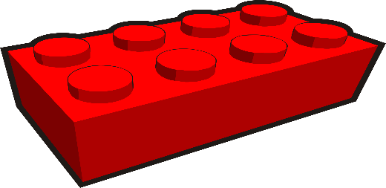

Changing the Conditions: Materials
So that the child succeeds:
start with a limited choice
gradually introduce more choice
Notes:
Changing conditions: materials
We can
reduce choice
exaggerate the difference in the attribute you are teaching
Gradually we
introduce more choice
reduce the difference as the child learns
Resources to demonstrate, e.g. red and blue bricks, big and little teddies
You may find it is helpful to have materials available to demonstrate this point
Demonstrate failsafe learning when asking a child to find a coloured brick – offer them 5 red bricks, then 4 red 1 blue, then 3 red 2 blue

Slide 20




Changing the Conditions: Materials
start with a very big difference
gradually reduce this difference
Notes:
It is much easier for the child to start with very obvious differences

Slide 21
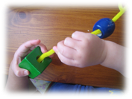
Changing the Conditions:
Grading Materials
Example Threading
  hoops + wooden spoon
  large beads + stiff cord (washing line)
  large beads + thick lace firm end
  medium beads + thick lace firm end
  small beads + thin lace firm end
  small beads + thin lace
Notes:
Changing conditions: grading materials
Activity: grading materials
This method is often used when teaching manipulative skills e.g. threading
The activity may be simplified by changing the materials used
A very easy version of the final activity is used at the beginning, maintaining the essential target behaviour (e.g. threading with a wooden spoon)
The materials are changed step by step as the child learns and approaches the goal
The aim of the activity is to give participants experience of grading materials themselves

Slide 22
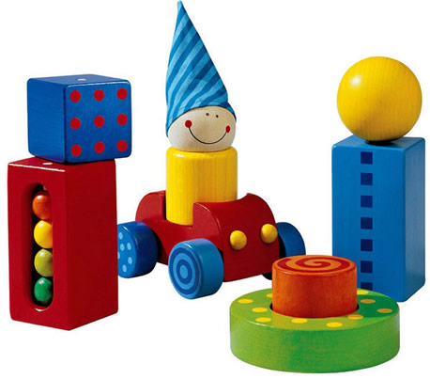
Activity
On your table you will find a selection of materials used by Early Years Providers
Grade these from easiest to hardest
What factors did you consider important when grading?
Notes:
Give each table a bag of toys for participants to grade. Suggested items include the following, puzzles, mark making, imaginative play, container play to peg boards, The aim of the activity is to give participants experience of grading materials themselves. Take feedback from each table, bringing all the participants togther and encourage discussion about the way that the materials have been ordered.

Slide 23
Changing the Conditions: Instructions
Model + verbal
Demonstration + verbal
Verbal
Notes:
Changing conditions: instructions
A task may be simplified by breaking down instructions:
modelling - when the adult completes the task and leaves this concrete example for the child to copy
demonstration – when the adult completes the task and the child imitates the action without the concrete example
modelling and demonstration are accompanied by verbal instructions
verbal – only verbal instructions are used
signing may accompany verbal instructions if this is appropriate for the child
The example of building a brick tower could be given here:
Modelling: adult builds a tower of bricks and leaves for the child to see. Adult gives child another three bricks and ask her to build a tower.
Demonstration: adult demonstrates building tower of three bricks, gives child the same bricks and asks her to build a tower.
Verbal: adult gives the child three bricks and asks her to build a tower.

Slide 24
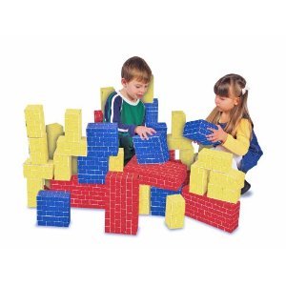
Example of Changing the Instructions
Building a Tower of Bricks
Model + verbal
Demonstration + verbal
Verbal
Notes:
The example of building a brick tower could be given here:
Modelling: adult builds a tower of bricks and leaves for the child to see. Adult gives child another three bricks and ask her to build a tower.
Demonstration: adult demonstrates building tower of three bricks, gives child the same bricks and asks her to build a tower.
Verbal: adult gives the child three bricks and asks her to build a tower.

Slide 25

Changing the Conditions: Context
This involves changing the circumstances
e.g. how many other children are involved or where the activity takes place (e.g. home or nursery)
Notes:
Changing conditions: context
Activity: changing the context
This might relate to place, people or time.
Start with a simpler or less demanding context and gradually change this until the Long Term Goal is reached
Give examples
Introduce activity by saying this is probably a familiar situation as some children may find it hard to share books and stories
The aim of the activity is to introduce participants to thinking about what might be possible steps to the goal by changing the context. This can be done in pairs.

Slide 26
Activity
Changing the context
‘Looks at book with an adult for 1 minute’
‘Looks at a book with an adult and 2 other children for 5 minutes’
What are some of the possible steps in between?
Notes:
Introduce activity by saying this is probably a familiar situation as some children may find it hard to share books and stories
Trainers may prefer to use a different changing the context activity here

Slide 27
Changing the Degree of Success
Success Criteria
TO WHAT DEGREE OF SUCCESS?
Duration
Frequency
Time
Notes:
Changing the degree of success
This is expanded on the next slide

Slide 28

Changing the Degree of Success
Time: alter the time allowed for task completion
Duration: alter the duration of the task
Number of tries: alter how many or time needed to achieve
Notes:
Changing the degree of success
A task can be made easier by changing the degree of success required:
the time allowed (for completion of the task)
duration (the length of time the task lasts)
frequency (e.g. the number of tries)
Example Time: child will put on shoes in 2 minutes then in 1 minute
Example Duration: child will sit unsupported for 30 seconds and then for 1 minute
Example Number of Tries: move from “Maya will select red object 9/10 tries” to “Maya will select red object 1/10 tries”

Slide 29

Activity
Watch the video
Decide on a possible Long Term Goal for the child and use a small steps approach to make it more manageable to achieve
Notes:
Activity: Using a Small Steps Approach
The focus here is to bring together elements of this and the previous sessions to decide on a goal using clear language and to attempt to break the goal down using a small steps approach
Use the video material to give participants the opportunity to practice writing a small steps plan for a child (activity sheet PP 29
Video material could use Liam or Maisy
Activity Sheet PP 29
Ensure participants are clear about what they need to do
Trainers may wish to take this opportunity to support individuals and ensure key learning points have been understood.

Slide 30
Breaking Down into Small Steps
Behaviour
What the child is expected to do
Conditions
Prompts
Success Criteria
TO WHAT DEGREE OF SUCCESS?
Materials
Instructions
“DOES WHAT?”
UNDER WHAT CONDITIONS?
Time
Context
Duration
Frequency
Notes:
Recap and link to Portage Principles
Recap using previous slide on breaking things down
Recap outcomes for participants
At this stage, trainers may wish to remind participants to complete the evaluation form for this section of the course.

Slide 31
partnership
generalising skills
celebrating success
inclusion
celebrating diversity
small steps
PORTAGE PRINCIPLES
enabling
being positive
supporting
looking forward
whole child, family and community
practical, immediate, relevant
Notes:
Recap and link to Portage Principles
Recap using previous slide on breaking things down
Link to Portage Principles-remind participants of the principles covered in this session, particularly
Being positive
Small steps
Looking forward

Slide 32
Outcomes for Participants:
Small Steps Approach
To show you are able to break down tasks in a variety of ways to make learning easier
To plan a sequence of small steps towards a Long Term Goal from where the child is now (baseline)
Notes:
Recap outcomes for participants

Slide 33
Small Steps Approach:
Objectives
Participants will be able to:
Break a task down into component skills as a task analysis
Name the different types of prompts that support learning
State what elements can be changed to make a task easier
Plan a sequence of small steps towards a Long Term Goal.
Notes:
Share outcomes for participants
At this stage, trainers may wish to remind participants to complete the evaluation form for this section of the course.

