Slide 1

Planning, Recording and Sharing Children’s Targets
To understand that there are different models for planning, recording and sharing information and in what circumstances these should be used
To use a model for recording an open-ended activity to plan a play activity for a child
To recognise the essential elements that should be included in an outcome-focused activity plan
Notes:
PERFORMANCE OF PRESENTERS: Total time 60 minutes
Ensure that participants’ understanding and learning in this module fit clearly within the overall Portage model and philosophy.
Define and discuss open ended and outcome focused activity plans
Discuss the reasons to make and share recorded information.
Present examples of open ended and outcome focused activity plans used in Portage
Discuss good practice points for planning and sharing progress
Ensure that this module builds on and consolidates earlier learning

Slide 2
Planning, Recording & Sharing Children’s Targets.
Outcomes for Participants
To understand that there are different models for planning, recording and sharing information and in what circumstances these should be used
To use a model for recording an open-ended activity to plan a play activity for a child
To recognise the essential elements that should be included in an outcome-focused activity plan
Notes:
OUTCOMES FOR PARTICIPANTS:
Understand that there are different models for planning, recording and sharing information and in what circumstances these should be used
Use a model for recording an open ended activity to plan a play activity for a child
Recognise the essential elements that should be included in an outcome focussed activity plan
Share the expected outcomes of the module for participants

Slide 3
Planning, Recording & Sharing Children’s Targets
Objectives
Participants will be able to
State the difference between an open-ended and outcome focused activity
Write an open-ended activity chart
Write an outcome focused activity chart
State one advantage and disadvantage of each.
Notes:
Share the expected objectives of the module for participants

Slide 4
The Portage Model
Structured Teaching
Family Focus
Child-Led Play
Portage
Notes:
Link to previous sessions
This session brings together the three elements of the Portage model; in particular child led play and structured teaching.
Share the expected outcomes of the module for participants

Slide 5
Reasons to make, use and share records of planned activities
Developing partnerships with parents
Showing progress
Sharing goals and activities with others
Identifying patterns of play and learning
Identifying next steps
Targeting areas of need
Celebration of success
The Importance of Recording and Sharing
Planned
Targets
Notes:
The importance of Planning, Recording and Sharing 60 minutes
Go through the chart and identify reasons why it is important to make, use and share records of planned activities
Trainers may wish to ask participants to produce their own ideas of ‘reasons to record’ before going through the list on the PowerPoint slide
Emphasise here the importance of partnership working - a joint approach between parents/carers and practitioners
long term aims /goals should be written as clear teaching targets using the who does what under what conditions, for a LTA the degree of success does not need to be included.

Slide 6
Types of Activity Plans Used in Portage
Open Ended
Observation of the child’s play and daily routines
Trying out new play ideas
Outcome Focused
Specific structured teaching activities
Planned as a teaching step towards a defined goal
Notes:
Introduce open ended and outcome focused categories for planned activities
Explain that both may have a role when planning, recording and sharing for children with SEND

Slide 7
The Portage Model
Structured Teaching
Family Focus
Child-Led Play
Open ended
activity plans
Outcome focused
activity plans
Notes:
Showing the Portage model demonstrates how the different types of activity plans fit in with the model; i.e. open ended plans fit well with child led play, whereas outcome focused plans involve structured teaching

Slide 8
Open Ended Activity Plans
This type of plan records ideas for the child’s play without a specific planned outcome.
Open ended activity plans:
Focus on child-led play
Are not prescriptive and can be easily changed following the child's lead
Recognises the importance of providing a range of opportunities and experiences around an emerging skill
Notes:
Types of Activity Plans Used in Portage
Introduce open ended and outcome focused categories for planned activities
Explain that both may have a role when planning, recording and sharing for children with SEND

Slide 9
Using Open Ended Activity Plans
Enables practitioners to observe a child’s response in order to plan future activities
Is varied in its approach
Focuses on a child’s interest and enjoyment
Can help generalise a newly learned skill into everyday life
Easy to record
Notes:
Open ended activity plans
Emphasise the point that an open-ended activity plan involves recording ideas for the child’s play without a specific planned outcome.
Emphasise the flexibility and broad range of the open-ended activity plan
Using open ended activity plans
Briefly describe the benefits of using open-ended activity plans
List some examples of different models that can be used
Focus on the Portage open-ended Activity Chart (bubble chart) as participants should be familiar with other types of EY planning
You may want to bring examples of open-ended planning from your area for this section

Slide 10


Example of a Portage Open Ended
Activity Chart
Name:
Activity:

Slide 11

Example of a Portage Open Ended
Activity Chart
Name:
Activity: Jumping
Jump off
bottom
step
Jumping
race with
friend
Practice
jumping
in puddles
Jump
to
music
Jumping
on
trampoline
‘Simon
says’ game
Jump in
and out of
hoop
Copy
teddy
jumping
Notes:
Talk through completed activity chart to ensure participants understand their possible uses
Explain that formats can take any shape you wish-pictures/photos make them more child friendly
You may wish to introduce additional examples of your own here, e.g. to demonstrate an open-ended activity plan that would be appropriate for a child with complex needs.

Slide 12

Name:
Date:
Activity:
Putting objects in a container
potatoes into a box
Pegs into washing basket
Bricks into a biscuit tin
Washing into the machine
Notes:
Another completed bubble chart (putting objects into containers)

Slide 13
Activity
Using the Open Ended Activity Chart provided, suggest suitable activities for a child from one of the areas of development below:
Picking up small objects between thumb and fingers
Finding nose, eyes or tummy as part of naming games
Makes a choice when shown two objects
Notes:
Activity 1
Practice using a Portage Open Ended Activity chart
Provide an opportunity for participants to complete a Portage Open Ended Activity Chart based on the areas of development taken from Development Matters in the EYFS
Suggested Activity Sheet 1 (bubble chart)
Point out that all 3 examples are taken from Development Matters in the EYFS under the heading ‘Characteristics of Effective Learning: The Unique Child’
Trainers may prefer to change PP to their own choice of activity

Slide 14
Outcome Focused Activity Plans
This type of plan details an activity that has been designed to achieve a specific goal, within a specific time, under specific conditions
It usually involves structured teaching and the individual elements of a teaching target are recorded
Notes:
Change presenter for this slide
Recap on the definition of an outcome focused activity plan.’

Slide 15
Using Outcome Focused Activity Plans
Can focus on a planned teaching step
Highlights goal to work towards
Includes details, such as strategies and prompts
Allows for consistent approach
Indicates progress
Notes:
Define outcome focused activity plans
Recap on the definition of an outcome focused activity plan
More structured approach - the focus is on the next ‘learning goal’
Recap the elements of a teaching target:
who
does what
under what conditions
to what degree of success
Refer back to the elements of the Portage model and emphasise that this involves structured teaching

Slide 16
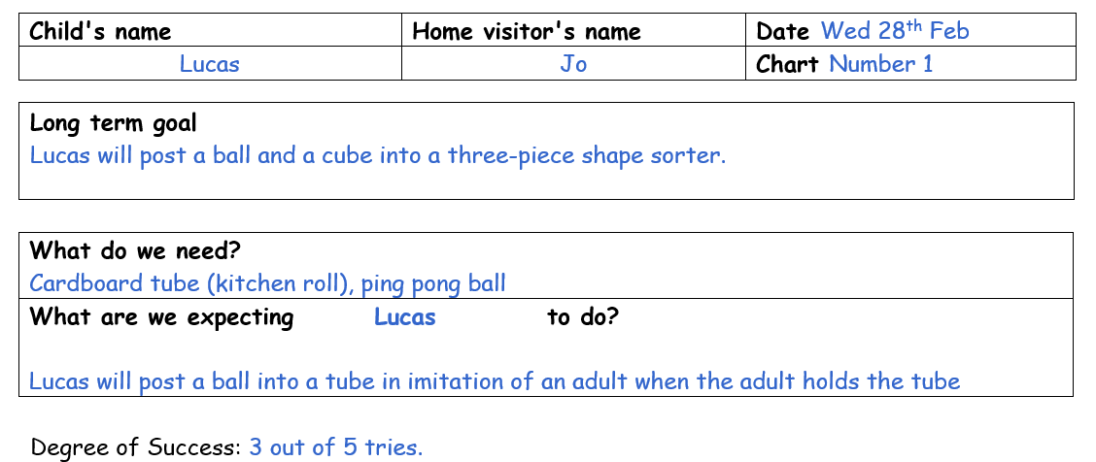
Portage Outcome Focused Activity Chart
Long Term Goal
Resources
Teaching Target
Who?
Does what?
Conditions?
Success criteria?
Notes:
Using outcome focused activity plans
Link this type of planning to IEP’s and EHC targets as you present this aim
More structured approach - the focus is on the next ‘learning goal’
Refer to Individual Education Plans here as an example that providers may be familiar with. Remind participants that these changed to ‘targeted plans’ under the 2015 SEND code of practice.
Make sure participants understand this chart is split over two slides to allow detail to be shown. Participants have a copy of this completed activity chart in their participant’s manual
Talk through each section highlighting key content
Trainers may wish to add local area examples

Slide 17
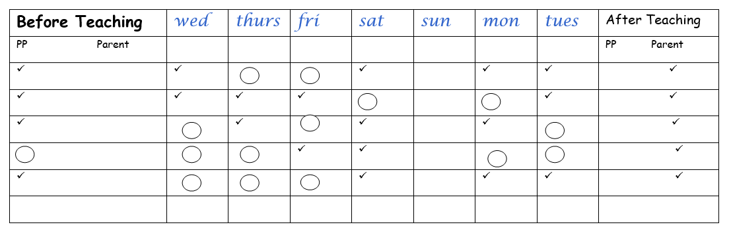
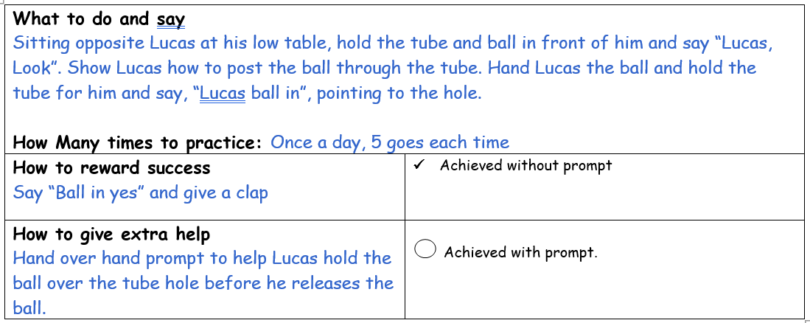
Portage Outcome Focused Activity Chart
Clear instructions for adults
Agreed reward
Additional support
Notes:
Second part of activity chart

Slide 18
Outcome Focused Activity Plans
Format may vary but core content should include:
  Long term goal
  Specific teaching target (4 elements)
  Resources required
  Instructions for adults (what to say /do and prompts to use / help to give to the child)
Notes:
Examples of outcome focused activity plans
Introduce some examples of ways to plan and record outcome focused activities which can be shared with families, particularly IEPs.
Cross reference with previous slide to highlight different aspects, such as working towards definite goals
Emphasise that the layout or format of the plan is not important, but rather the content and process of completing the plan in partnership with parents
Summarise the key content that should be included in an outcome focused activity plan
Presenters should have different examples to refer to of the range of activity planning and recording methods, ideally using real examples from your own experience / local area.
If time, trainers may wish to include an additional activity where participants practice completing their own outcome focused activity chart. A blank chart is included in the activity sheets for this module.

Slide 19
Summary
Recording and sharing our planned activities is helpful and gives clarity for providers, children and families.
The Portage Model uses open ended and outcome focused activity plans, which can be useful for recording and sharing planned next steps with colleagues and families.
The two types of plan are used flexibly according to the needs of the family
Notes:
Summary
Reinforce the importance of recording and the 2 types of activity plans used in the Portage model. Emphasise the flexibility of the model and that plans are used flexibly with families to suit their needs.
Link to Portage Principles -remind participants of the principles covered in this session, particularly:
Being positive
Celebrating Success
Looking forward
Supporting

Slide 20
partnership
generalising skills
celebrating success
inclusion
celebrating diversity
small steps
PORTAGE PRINCIPLES
enabling
being positive
supporting
looking forward
whole child, family and community
practical, immediate, relevant
Notes:
Link to Portage Principles -remind participants of the principles covered in this session, particularly:
Being positive
Celebrating Success
Looking forward
Supporting

Slide 21
Examples of Planning, Recording & Sharing Planned Activities:
Outcomes for Participants
To understand that there are different models for planning, recording and sharing information and in what circumstances these should be used
To use a model for recording an open-ended activity to plan a play activity for a child
To recognise the essential elements that should be included in an outcome-focused activity plan

Slide 22
Examples of Planning, Recording & Sharing:
Objectives
Participants will be able to:
State the difference between an open-ended and outcome focused activity
Write an open-ended activity chart
Write an outcome focused activity chart
State one advantage and disadvantage of each.
Notes:
Share the expected objectives for the module for participants
At this stage, trainers may wish to remind participants to complete the evaluation form for this section of the course.

