Slide 1

Portage Workshop
The Portage Model
Welcome
Notes:
PERFORMANCE OF PRESENTERS: Total time 90 minutes
Explain what Portage is and provide information on its effectiveness
Explain and illustrate the Portage model and principles and how they are incorporated in the work of Early Years settings
Discuss the importance and value of working in partnership with parents
Explain the National Context and current reforms in relation to Portage
Provide information on the National Portage Association
Welcome
To welcome participants
To introduce trainers
To go through “housekeeping” elements (toilets / fire procedures etc.)
Trainers may want to have own specific PPs for housekeeping
Icebreakers & ground rules
To introduce participants to each other
To set the scene regarding open discussion etc. in the workshop
Presenters may want to use icebreaker activities of their own here
Main points of ground rules, using the name cards with the ground rules one side, or could be put up on a flip chart.

Slide 2
Timetable
Day 1
The Portage Model
The Development of Play
A Parent’s Perspective
Using Clear Language
Planning Successful Outcomes
Day 2
Recording and Sharing Children’s Plans
The Small Steps Approach
Positive Approaches to Children’s Behaviour
Virtual Follow up session
Sharing experiences: successes and challenges
Next steps
Information for all modules is covered in the Participants Manual
Notes:
Course timetable
To enable participants to see an outline of the 2 days and what is included in each day, also for information re: timings and breaks.
NB: Modules may move within the timetable, depending on how the course is run. The parent perspective could follow The Small Steps approach module
Trainers should check time slot for setting the individual assignment at the end of day1 feedback given on day 2.
Highlight the Participants Handbook and that all information can be found in there and that it is not a copy of the power points
Day 1 l
The Portage Model 90 The Development of Play 70 mins
A Parent’s Perspective 30 mins
Using Clear Language 65 mins
Planning Successful Outcomes 110 mins
Day 2
Recording and Sharing children's plans 60 mins
The Small Steps Approach 135 mins
Positive Approaches to Children’s Behaviour 120

Slide 3
The Portage Model:
Outcomes for Participants
To understand the Portage model and how it supports children with SEND
To understand the Portage Principles and how they underpin the Portage approach
To recognise the importance of working in partnership with families
To understand the value of Portage in relation to national SEND reforms and new initiatives
Notes:
Outcomes of Workshop
To give participants an expectation of what they will be able to do after attending the Workshop
Ask participants if this is what they are expecting. Are there any other expectations? If so, write on flip chart to ensure covered.

Slide 4
The Portage Model:
Objectives
Participants will be able to:
Name the three elements of the Portage Model
List the benefits of partnership working
State the importance of using the Portage Principles when working with children and families
State how Portage links with SEN reforms
Notes:
Share the specific outcomes for this module participants will be able to do at the end of the module.

Slide 5
Background
Portage started in Portage, Wisconsin as a Home Visiting Educational Service for pre-school children with SEND and their families
Portage has supported and empowered families for over 40 years in the UK and overseas
Today, there are about 100 registered Portage Services in England and Wales
Notes:
Portage started in the 1960s in a town called Portage which is in Wisconsin in America. The town is in the middle of a large rural area and the psychologists seeing the children there were concerned that families were travelling long distances to see them and therefore they were not seeing the children’s true abilities. They realised that children usually learn best in their own homes and that parents/carers are usually the best teachers of their own young children. They therefore started travelling to see families in their own homes and devised a home teaching model where they could work in partnership with parents/carers to empower them to understand and meet the needs of their own children – Portage! This was very innovative thinking at that time.
.

Slide 6
The Portage
Model
Portage is a Home Visiting Educational Service for pre-school children with Special Educational Needs and Disabilities (SEND) and their families
Portage Principles and the Portage Model are also used within a range of settings

Slide 7
Models of Portage Practice
Practitioners using Portage Principles in their settings
Practitioners with elements of Home Visiting
Fully developed Portage Service, offering Home Visits
Notes:
Provide examples from local area to participants, to demonstrate the range of models of Portage e.g. full home visiting through to settings who have Portage trained practitioners and have embedded Portage Principles into practice / gained NPA Stamp of Approval
Supervision is a key part of delivering Portage with weekly or fortnightly sessions being essential for Portage practitioners.

Slide 8
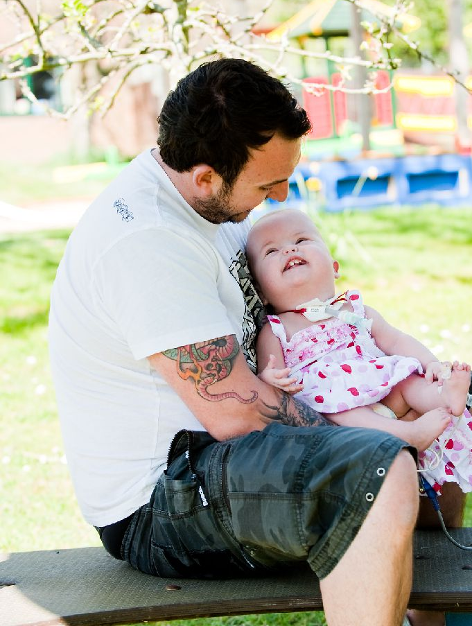
Portage Aims
To help children with SEND and their families:
  learn together
  play together
  participate and be included in their community
To help minimise the barriers confronting families
To support the national & local development of inclusive services
Notes:
Emphasise the learning through play and the link with the family and local community.

Slide 9
National Portage Association
Improving the learning of young children with disabilities and the skills of their parents, through providing quality training and support for Portage Practitioners and the Early Years Workforce
National Portage Association Mission Statement
www.portage.org.uk
Notes:
Aims of Portage & Role of National Portage Association
Introduce the National Portage Association as the over-arching organisation for registered Portage services and EY settings in England & Wales
Draw participant’s attention to the motto of the NPA (on the logo): Partners with Parents and Children and emphasise Partnership as the keystone of all Portage Practice.
The role of the NPA includes:
- Providing a Code of Practice for Portage Services and approved EY settings
- Providing information and peer support for Member Services and Approved EY settings
- Ensuring a high level of Portage service delivery across regions
- Supporting quality of service by providing guidance and training
Refer participants to written information about the NPA and the Portage website for further information.

Slide 10
Referrals to Portage
Criteria
Referral pathway
Contact with the family
Assess the needs of the child
Offer of Portage involvement
Notes:
Criteria is usually delays or difficulties ion two or more areas of development or the potential to meet this criteria e.g. a baby born with Down Syndrome .
Referral pathways. AT to talk through how this happens in their LA emphasise that it could be different in different areas.

Slide 11
Essential Elements of a Portage Session
Relationship with the family and Holistic Assessment
Play session where planned activities are reviewed
New activities tried
Joint decision what to work on next
Activity charts completed
Opportunity for families to discuss concerns regarding their child's learning.
Notes:
Essential Elements in a Portage Home Learning Session
Establishing an appropriate relationship with parent and child.
Discussion and recording the outcome of last week’s activities including daily recording on charts.
Choosing activities to work on based on the child’s responses during the visit, where possible using the toys the child has at home.
Planned activities
Joint planning of next week’s activity
Parent observes Portage Practitioner modelling teaching activity with child
Portage Practitioner observes parent working with child, recording baseline
Child’s play
Observation of child led play to check on emerging skills and discuss opportunities for maintenance and generalisation of recently acquired skills. This reflects how successful the Portage sessions and aims set have been in supporting the child’s learning.
Families' priorities
An opportunity for parent to raise concerns regarding their child’s early education. Portage Practitioners to signpost families to other professionals as required. Not taking the lead but allowing the family to do this.
Portage Checklist The baseline should be established and aims set within 4 -6 sessions following the initial visit
Reviewing of Goals - These are usually set every 3-4 months and as part of this discuss with the family to see if they want Portage to continue.

Slide 12
Portage Principles
Partnership
Supporting
Practical, immediate, relevant
Whole child, family and community
Notes:
Activity I Set of props that illustrate each Principle
Illustrate the Principles from your own experiences. The Portage Principles could also be displayed for reference during the workshop.
Partnership
One of the fundamental principles of Portage. Working together in partnership with parents as the senior partner. We also work in partnership with other professionals.
Supporting
Parents play a key role in supporting their children and we play a key role supporting them to do this
Practical immediate and relevant
Services are most useful when they support everyday living and delivered in the child’, Solving issues as they arise with simple solutions that families can be part of straight away. Skills taught are then meaningful and appropriate. Giving families practical things to try with their child.
Whole child family and community
The right to be included and participate in the community. We are all in this together

Slide 13
Portage Principles
Celebrating diversity
Inclusion
Enabling
Generalising skills
Notes:
Celebrating Diversity
Every child and every families of equal worth and has the right to be valued for their individuality. This is not just about things like race and religion but about how each family chooses to live their lives.
Inclusion
We support children and families to have equal access to opportunities and resources, which are ordinarily available to others. Everyday contacts, relationships and activities are fundamental in nurturing development, quality of life and experiences.
Enabling
This is about a can-do approach and finding ways to support achievement.
Generalising skills
Every child has the right to enjoy the widest range of play experiences as they are the foundation of learning and development. We ensure that all skills that are achieved can be used anywhere and under any conditions.

Slide 14
Portage Principles
Looking forward
Being positive
Celebrating success
Small steps
Notes:
Looking forward
Childhood is the foundation on which children build the rest of their lives. It’s not just preparation for the next stage, it’s important in itself
Being positive
All children are able to learn. Building on strengths and abilities rather than focusing on difficulties best supports progress. Success comes in can and not cant’s.
Being positive and realistic about what we are trying to achieve.
Celebrating Success
Each success builds on the next and the child and family will then want to try new activities so making progress.
Small steps
Learning is better achieved when its broken down into smaller achievable steps, this approach can be applies through out the child’s/families life.

Slide 15
partnership
generalising skills
celebrating success
inclusion
celebrating diversity
small steps
PORTAGE PRINCIPLES
enabling
being positive
supporting
looking forward
whole child, family and community
practical, immediate, relevant
Notes:
Stress the importance of each principle in underpinning all Portage practice. Bring in:
- confidentiality
- cultural diversity
- ethnicity
- family structure
Portage Home Visitors are professionals working to a code of professional conduct
Illustrate the Principles from your own experiences. The Portage Principles could also be displayed for reference during the workshop.

Slide 16
Discussion
Consider the 12 Portage Principles. Discuss on your tables how they may already be incorporated in your work
Feedback examples to the whole group
Notes:
The aim of the discussion is to enable participants to reflect on the relevance of the 12 Portage Principles and how they are already incorporated into EY practice

Slide 17
How Portage and the Early Years Foundation Stage (EYFS) Principles Link Together
A Unique Child
Enabling Environments
Learning and Development
Positive Relationships
Celebrating diversity
Whole child, family and community
Partnerships
Looking forward
Being positive
Inclusion
Supporting
Practical, immediate, relevant
Enabling
Small steps
Generalising skills
Celebrating success
Notes:
Change Presenter
Concentrate on emphasising how the themes of the EYFS link in with the Portage Principles
Focus on how many of the principles are already embedded in EY work and when supporting children and young people with SEND and broadly for all children in Early Years.

Slide 18
The Portage Model: The Three Elements
Structured Teaching
Family Focus
Child-Led Play
Portage
Notes:
It is a dynamic model, with not every element being present in every session. However, it is important that practitioners are aware of the elements and ensure that they are not concentrating on one. E.g. If a great deal of time is spent on Family Focus, it may be necessary to make referrals to other agencies.

Slide 19
Child-Led Play
Time spent reviewing and planning
opportunities for child’s independent play
and includes:
Responding to child led free play
Generalising newly acquired skills
Discussing play with parents
Recording significant play observations
Notes:
Talk through the slide

Slide 20
Family Focus
Time spent sharing and addressing family priorities, for example:
sharing daily experiences and routines
addressing needs and looking forward
sharing information
empowering parents
promoting inclusion
sign posting
Notes:
Links with parents is crucial for partnership working and to promote the inclusion of all children.

Slide 21
Structured Teaching
Time spent reviewing and planning activities
Joint planning and practice of an activity
Checking what has happened since the last
visit or teaching session
Deciding what to do next with family or key person
Trying out a new activity and reviewing its success
Notes:
Planned activities that have been informed by the family's priorities and the child's skills and interests.
Activity. You may want to use photos of children carrying out different aspects of family focus, child led play and structured teaching for participants to decide which areas they fit into.

Slide 22
The Strength of the Portage Model
Portage:
Works in partnership with parents
Emphasises current skills
Uses holistic assessment
Is positive in its ethos
Introduces the small step approach
Notes:
Overall strengths of the model. Explain that the following slides will look at the model in more detail.

Slide 23
Portage and Working in Partnership
Portage
Home Visitor, Team & Supervisor
Family
Parents/Carers, Siblings, Wider Family
Other Agencies
Including Early Years Providers
Child
Notes:
Working in partnership is central to the Portage approach. It helps provide a holistic view of the child which also takes into account the needs of the wider family and helps coordinate the support that the Early Years Providers and other agencies can provide.

Slide 24
The Importance of Working in Partnership
“Children learn and develop well in enabling environments with teaching and support from adults, who respond to their individual interests and needs and help them to build their learning over time”
Children benefit from a strong partnership between practitioners and parents and/or carers.
Statutory framework for the EYFS 2021
Notes:
Quotes are provided that reference the importance of partnership.

Slide 25
The Importance of Working in Partnership
“For very young children, local authorities should consider commissioning the provision of home-based programmes such as Portage, or peripatetic services for children with hearing or vision impairment”
“Parents should be fully involved in making decisions about the nature of the help and support that they would like to receive”
SEND Code of Practice 2015 9.144
Notes:
Explain Early Support started in 2004 as a Government initiative to put families at the centre of any decision-making process. Now embedded in many local authorities Early Years SEND teams, often sitting within Portage services

Slide 26

Activity
In pairs, think of a relationship you have which you would consider to be an effective partnership
List the key elements that make it an effective partnership
Which of these elements do you think are important when working with children and families?
Notes:
Activity: What makes an effective partnership? Discussion in pairs or as a whole group, could record on a flip chart
Feedback and ask for examples of good practice when working in partnership with parents and carers of children with SEND.

Slide 27
Effective Partnership Working
Complementary expertise
Agreed aims
Mutual respect
Open/Honest/Genuine
Trust
Flexibility
Good communication
Negotiation
Empathetic
Notes:
Make sure basic elements of partnership working have been covered in the discussion/feedback.
Mutual Respect- makes others feel that they are important and worthwhile. Giving positive attention, active listening, giving time freely without making the person feeling intrusive, remembering the person's name, introducing yourself, basic courtesy, asking questions gently, checking out assumptions you have made about the person, not interrupting or talking over the other person.
Open Honesty, Genuine - behaviour that conveys to others that you are human, trustworthy, not hiding behind roles or facades, spontaneous and open about yourself in an appropriate manner. Responding naturally, not being defensive, not pretending to be something you are not.
Empathy - behaviour that shows you understand the other person’s world as they are experiencing, you see it their way, shown by reflecting back to the other person feelings you are picking up” that must have been really difficult” Showing warmth, let your body language reflect the other person’s feelings

Slide 28
Activity
In pairs, think of the barriers there may be to partnership working
Notes:
Activity: What makes an effective partnership? Discussion in pairs or as a whole group
Feedback and ask for examples of good practice when working in partnership with parents and carers of children with SEND.

Slide 29
Possible Barriers to Partnership Working
Not having or planning the time and place for conversations
Expert model
Colluding and taking the family’s side
Being too involved
Over identifying with the family
Language
Past negative experiences
Notes:
Barriers to be discussed could include
Privacy, GDPR, time and place for conversations
Expert model- families feeling inadequate due to professionals working with the child and getting the child to respond.
Suggesting the family do something when they don't have the resources.
Not recognising the parents' expertise.
Withholding information, knowledge is power.
Colluding, crossing the professional line
Over identifying If it was my child I would…………… your opinion before the families, oversharing your personal story
Being too involved, offering to help at other times or taking an issue on that should really be signposted.
Any action where you cannot maintain your professional relationship with the family
Talking about one of my families, one of our children, being possessive about the families you work with
Not just EAL but the language we use and what we say, particularly the use of Acronyms

Slide 30
Portage is Effective Early Intervention
“Early support for families …….can take a number of forms, including …home based programmes, such as Portage, which offer a carefully structured system to help parents support their child’s early learning and development.” (5.15 & 5.16)
“Portage workers also identified as appropriate specialists…able to identify effective strategies, equipment, programmes or other interventions to enable the child to make progress..” (5.48)
SEND Code of Practice 2015
Notes:
Bring previous slides together here to focus on the particular benefit of Portage as a targeted early intervention
Portage is recognised in the 2015 SEND guidance as an effective early intervention, and Portage practitioners as appropriate to carry out this intervention

Slide 31
Summary:
The Benefits of the Portage Model
An approach that is reinforced by current national initiatives and reforms
Key core principles that are in line with EYFS guidance
Provides a strong and positive model of support for Practitioners when working with children with SEND and their families
Notes:
Emphasise how Portage is a beneficial model for EY settings to use when developing an approach for working with all children and especially with SEND and their families.
Brief summary of the recent reforms
Education, Health Care Needs Assessments from 0-25
Local authorities now publishing details of how children with SEND are supported through their ‘local offer’
Targeted early intervention, with a growing number of children with SEND attending EY settings from age 2
Portage supports the implementation of many of these key national priorities – early intervention, improving outcomes for disabled children, multi-agency working, parents as partners. There is a growing body of evidence around the features of effective interventions that improve outcomes for vulnerable groups of children, including those with SEND. Link this in with the ethos of Portage as being an early intervention service and home visitors’ role.
working in partnership with parents and other professionals
Implementing a personalised, structured teaching programme
Supporting and upskilling EY practitioners (including Portage training/workshops)Portage is recognised in the 2015 SEND Code of Practice as an effective early intervention, and Portage practitioners as appropriate to carry out this intervention

Slide 32
partnership
generalising skills
celebrating success
inclusion
celebrating diversity
small steps
PORTAGE PRINCIPLES
enabling
being positive
supporting
looking forward
whole child, family and community
practical, immediate, relevant

Slide 33
The Portage Model:
Outcomes for Participants
To understand the Portage model and how it can support the work of settings with children with SEND
To know the Portage Principles and how they can be used in settings
To recognise the importance of working in partnership with families
To understand the value of Portage in relation to national SEND reforms and new initiatives

Slide 34
The Portage Model
Objectives
Participants will be able to:
Name the three elements of the Portage Model
List the benefits of partnership working
State the importance of using the Portage Principles when working with children and families
State how Portage links with SEN reforms
Notes:
Ensure objectives have been achieved with the group, go through slide

